Slide 1
Engine Controller
Team 513

Slide 2




Team 513
Patrick Marlatt
Project
Engineer
Fred Peterson
Software Engineer
Austin LaFever
Lead Controls Engineer
Jonathan Wozny
Fluids and Test Engineer
Frederick Peterson

Slide 3
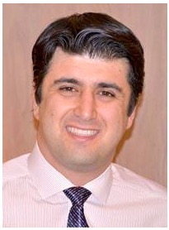
Sponsors and Advisor
Engineering Mentor
Roberto Valenti
Project Advisor
Engineering Mentor
Peter Maloney
Controls Advisor
Academic Advisor
Dr. Shoele, Ph.D.
Assistant Professor
Frederick Peterson

Slide 4
Objective
The goal of this project is to create and implement a multi-input multi-output control system for airflow components in the Mathworks Powertrain Blockset.
Frederick Peterson

Slide 5



Motivation
Internal combustion engines will be prevalent for the foreseeable future.
Modernize Mathworks' engine control unit for Powertrain Blockset engine simulation with multi-input/multi-output controller.
Improve torque-tracking in engine dynamometer simulation.
Frederick Peterson
Notes:
We are starting the process of modernizing their engine control unit with multi-input multi-output → their control setup is pretty outdated and used only single input single output
Will need to explain what a dynamometer is.

Slide 6
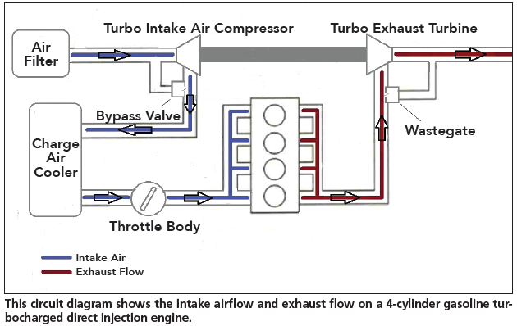
Recap: Model
Control
Variables
Frederick Peterson
Notes:
Throttle lets air into the system. When you press on the gas, the throttle opens up to allow the "commanded amount" of air which then mixes with fuel is ignited and powers the car to move pretty much. Air goes through the wastegate.
A wastegate is a valve that controls the flow of exhaust gases to the turbine wheel in a turbocharged engine system (if not needed it sends it straight out as exhaust).
The turbine wheel is rotated and this compresses air into the cylinders to increase power output.
We have throttle there b/c it is the same thing as ”ambient air inlet”

Slide 7
Recap: Needs
Throttle Control
Multiple Input/
Multiple Output
Wastegate Control
Solution
Improved Torque
Output
Comprehensive
Frederick Peterson

Slide 8
Recap: Needs
Throttle Control
Multiple Input/
Multiple Output
Wastegate Control
Solution
Improved Torque
Output
Comprehensive
Frederick Peterson

Slide 9
Recap: Needs
Throttle Control
Multiple Input/
Multiple Output
Wastegate Control
Solution
Improved Torque
Output
Comprehensive
Frederick Peterson

Slide 10
Recap: Needs
Throttle Control
Multiple Input/
Multiple Output
Wastegate Control
Solution
Improved Torque
Output
Comprehensive
Frederick Peterson

Slide 11
Recap: Needs
Throttle Control
Multiple Input/
Multiple Output
Wastegate Control
Solution
Improved Torque
Output
Comprehensive
Frederick Peterson

Slide 12
Recap: Functional Decomposition
MIMO Control System
Air Flow Control
Receives Throttle Position Command
Receives Wastegate Position Command
Returns Throttle Position
Returns Wastegate Position
Handles Differing Parameters
Operates for Varying Displacements
Operates for Varying Desired Powers
Operates for Varying Number of Cylinders
Integration
Works in conjunction with current feed forward controls
Estimation Improvement
Drive Lambda ~ 1
Improve Time Response
Measure Error
Receives Multiple Inputs
Returns Multiple Outputs
Align Output Torque with Desired
Frederick Peterson

Slide 13
Recap: Targets and Metrics
Function
Align Output Torque with Desired
Works with Feed Forward Controls
Multiple Inputs
Multiple Outputs
Metric
Percentage
Boolean
Integer Count
Integer Count
Target
1.75 % error
1
2
2
Frederick Peterson

Slide 14



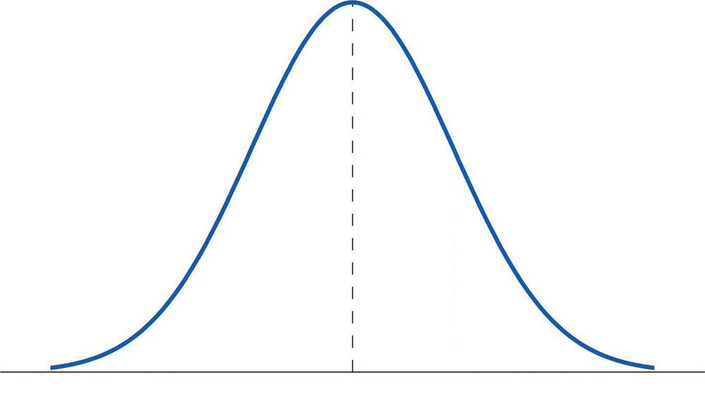





Concept Selection: Decision Criteria
Speed
Can Be Moved to Other
Sections
Accuracy
Measure Error
Can Handle Changed Engine
Parameters
Controls Lambda
MIMO
Improve Time Response
Frederick Peterson

Slide 15
MPC Background
Final Design Chosen: Quadratic MIMO MPC After Tables
  Constraints, models, input, output are all defined by the design team
Throttle
Command
Matlab Blockset
MPC Controller
New Throttle Command
Plant
More accurate torque value
Wastegate Command
New Wastegate Command
Torque Command
Frederick Peterson
Notes:
Higher level

Slide 16
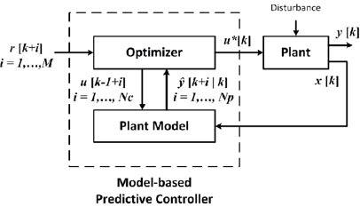
MPC Components
MPC Outputs:
Throttle
Wastegate
Actual Torque Value(s)
Desired Torque Value(s)
Frederick Peterson
Notes:
Lower level explanation (higher level is slide before)

Slide 17
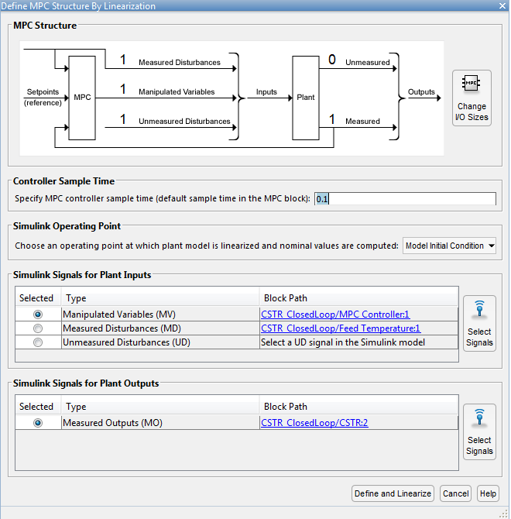
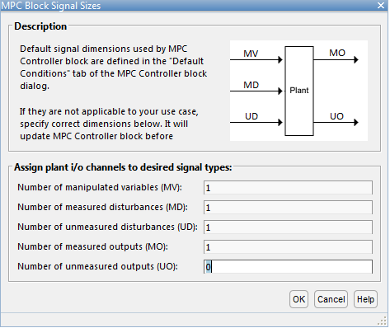
MPC Design Approach
Matlab includes MPC design software.
It is not the most intuitive, but far better than programming a new one.
Attempt to make a variation from the MPC-Simulink tutorial
Frederick Peterson
Notes:
- First bullet: matlab has the Model Predictive Control Toolbox that you can use in Simulink
MPC can handle multi-input multi-output (MIMO) systems that have interactions between their inputs and outputs. Due to these interactions, it is often challenging to design MIMO systems using traditional controllers such as PID. However, MPC can simultaneously control all the outputs while taking into account input-output interactions.
MPC can also handle constraints. Constraints are important, as violating them may lead to undesired consequences. MPC has preview capabilities (similar to feed-forward control). If set point changes are known in advance, the controller can better react to those changes and improve its performance.

Slide 18
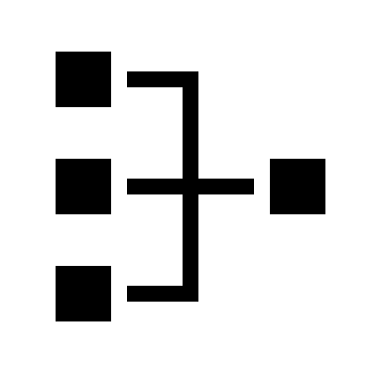
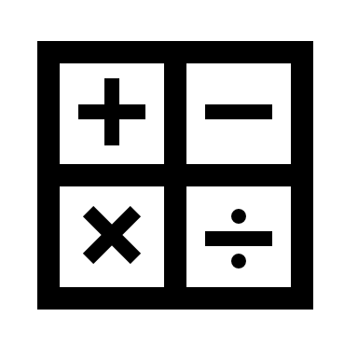


Advantages of MPC
Can handle multi-input multi-output (MIMO) systems
Can handle system constraints to avoid undesired consequences
Computation requirements can be managed
For this application: typically used in auto and aero industries
Jonathan Wozny
Notes:
We are starting the process of modernizing their engine control unit with multi-input multi-output → their control setup is pretty outdated and used only single input single output
First bullent point: can deal with interactions between inputs and outputs (both inputs can affect both outputs --> can handle this)
Second bullet point:

Slide 19
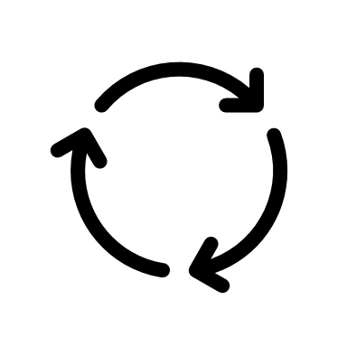



Disadvantages of MPC
Computation must be carried out for every iteration
More complex than standard controls
Appropriate model is necessary to optimize the controller
Requires more computing power
Jonathan Wozny
Notes:
- first bullet: every time it does something, it has to recalculate
- second bullet:
- third bullet: need to have a good model mathematically of the system --> which could be a bit difficult sometimes

Slide 20
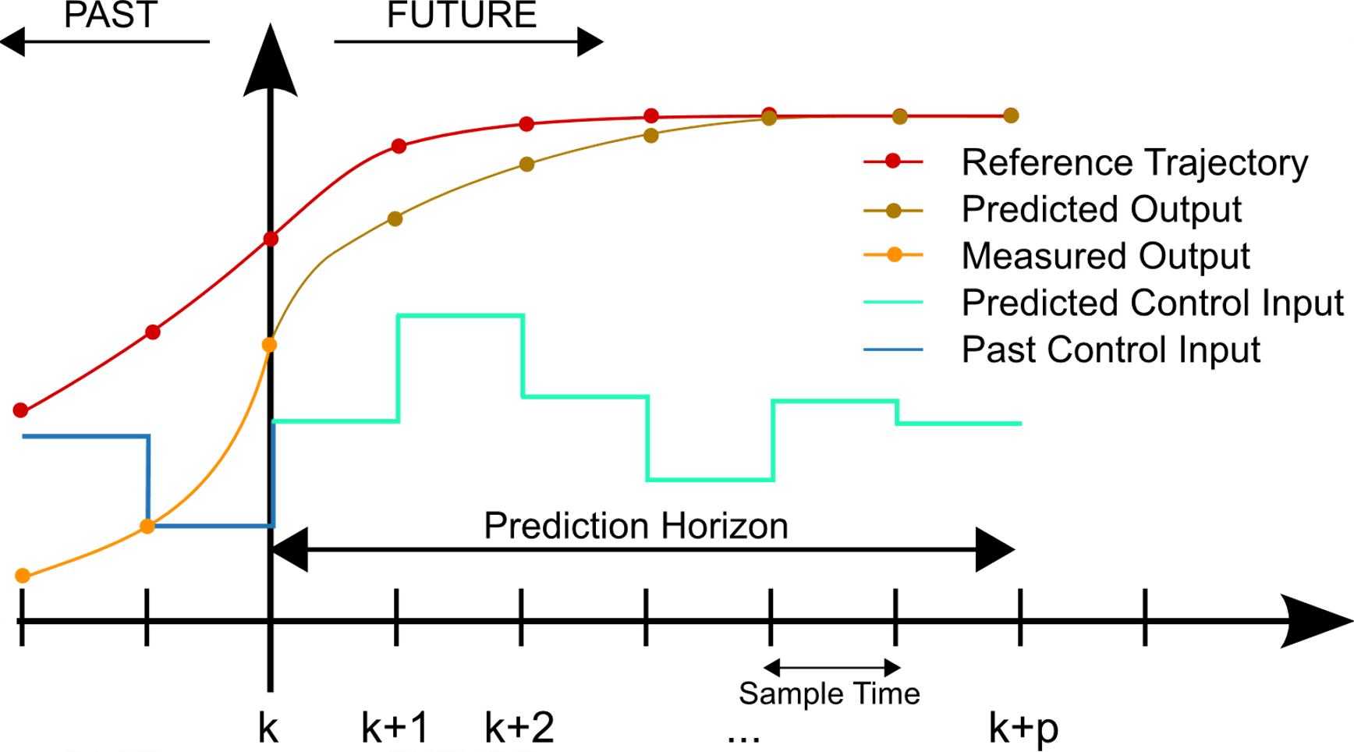
MPC Plant Visualization
Our Variables
Desired Output Torque
Predicted Torque
Measured Torque
Predicted Throttle/Wastegate
Past Throttle/Wastegate
Jonathan Wozny
Notes:
Reference trajectory is everything that has happened --> what the output controls torque
Measured output is what the mpc has output in the past (throttle and wastegate)
This graph is referencing the plant meaning the output of the plant is the torque and the input of the plant is the MPC's output (I.e. throttle and wastegate)

Slide 21
MPC Terminology
Control Objective = The desired outcome of the controlled system
Prediction Horizon = How far ahead the model predicts/simulates the future
Control Horizon = How far ahead the controller prepares changes to the model
Controller Sample Time = Length of timesteps of prediction
Constraints = Upper and/or lower boundaries to prevent unwanted outcomes
Jonathan Wozny
Notes:
We are starting the process of modernizing their engine control unit with multi-input multi-output → their control setup is pretty outdated and used only single input single output
Constraint example --> throttle area available for airflow

Slide 22
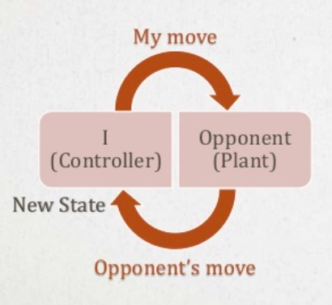


MPC Chess Analogy
Control Objective – The goal, to checkmate
Optimization Problem – Figuring out the quickest or
most optimal way to complete the objective
Prediction Horizon – How many moves ahead to look for
the strategy (limited by the chess clock)
Update strategy/prediction horizon after every opponent move
Predict opponent's moves and counter them
Controller Sample Time – How long to simulate control output. Not heavily related to chess, but closest is one move per player per turn
Constraints – Limitations on output, or how each piece can move
*MPC isn't actually used for chess. Closest would be a breadth first search(BFS).
Jonathan Wozny
Notes:
Fourth bullet point: For updating the strategy after every opponent's move, you need to find the right balance of how far you are looking ahead into your strategy; is same as first on disadvantages

Slide 23
MPC Plant Visualization
Our Variables
Desired Output Torque
Predicted Torque
Measured Torque
Predicted Throttle/Wastegate
Past Throttle/Wastegate
Jonathan Wozny
Notes:
Reference trajectory is everything that has happened --> what the output controls torque
Measured output is what the mpc has output in the past (throttle and wastegate)
This graph is referencing the plant meaning the output of the plant is the torque and the input of the plant is the MPC's output (I.e. throttle and wastegate)

Slide 24



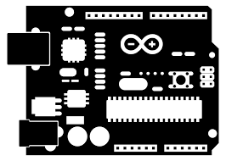
Validation
Validation done by checking the commanded torque vs. output torque graph
Two methods of validation:
Software → running the simulation and comparing error
Hardware in the loop (HIL) validation
Jonathan Wozny
Notes:
This slide basically plainly states that we have two different ways to test it --> by running the simulation and checking for improvements. Then actually running it through hardware to simulate how well it can respond in with physical signals.

Slide 25
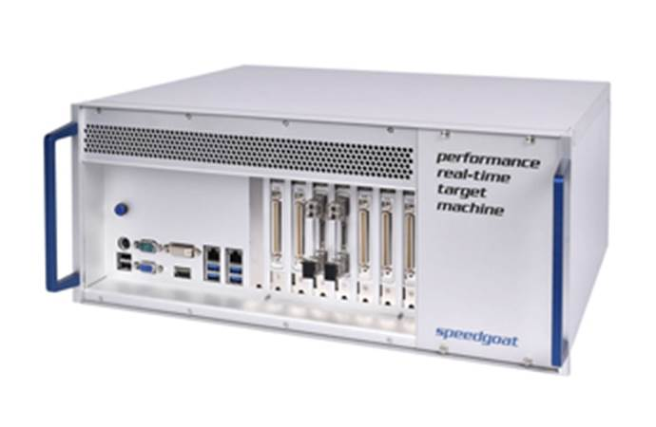



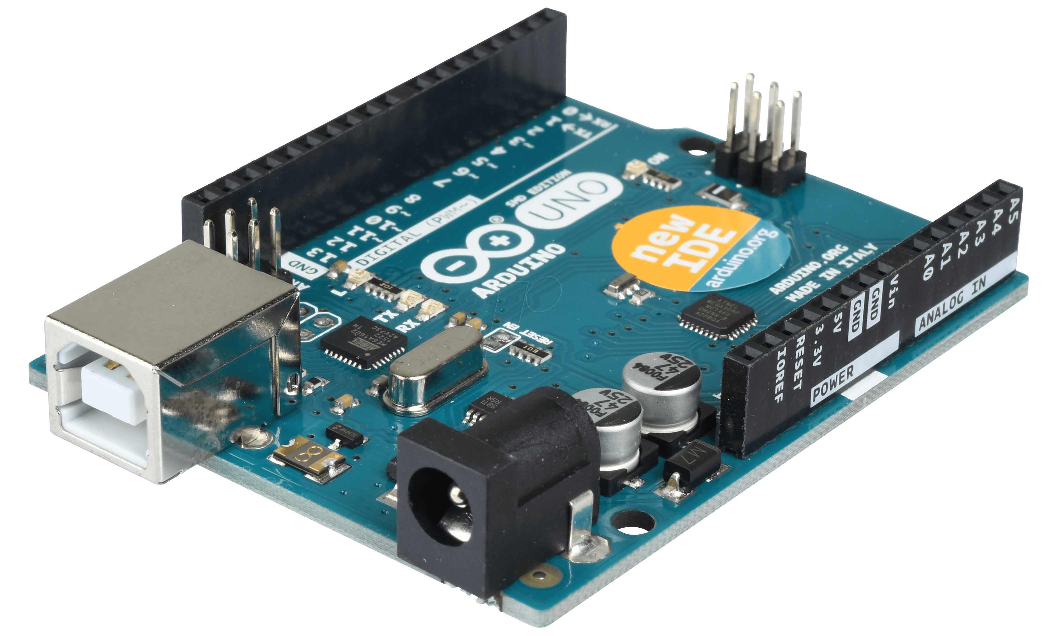


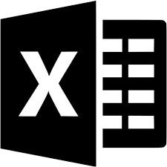

Validation: Hardware
                Speedgoat
                Expensive
                Configure for specific requirements
                Made to work with Mathworks products
                Arduino/Raspberry Pi
                Inexpensive
                Can run Simulink projects through Arduino/RP with add-ons
                Can send output data to Microsoft Excel
                How can we fake an engine?
Jonathan Wozny
Notes:
Speedgoat is super expensive, like over a thousand dollars. You can have it built for what you want to test specifically. It has its own software that you would need in order to operate it and test with it though.
Need to put in some research to see if one or the other works better.
Arduino uses Data-Streamer add-on to send data right into excel
Raspberry Pi can save data as CSV file --> can put into excel

Slide 26
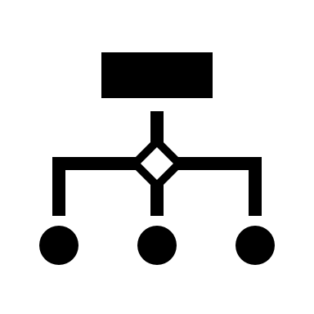





Future Research
MPC implementation
Selecting accurate and effective hardware for physical testing → i.e. the resolution of the data when we ”fake an engine”
Existing Arduino or Raspberry Pi setups
Constraints on system
Jonathan Wozny

Slide 27

Conclusion
MPC is a good control method to produce accurate results, minimizing error
Matlab includes built-in MPC mechanics and designers, we are responsible for inputs, outputs, plants, control settings, and implementation
HIL Testing - Arduino or Raspberry Pi are less expensive options than commercial testing options
Jonathan Wozny

Slide 28
Semester Plan
 | January |  | February |  |  |  | March |  |  |  | April
MPC Prototyping
HIL Research
VDR 4
Working HIL
MPC Throttle
MPC Wastegate
VDR 5
Final Build
Validated Software
Senior Design Day
Jonathan Wozny

Slide 29
References
Bemporad, A., Bernardini, D., Long, R., & Verdejo, J. (2018). Model Predictive Control of Turbocharged Gasoline Engines for Mass Production. SAE Technical Paper Series. doi:10.4271/2018-01-0875
Hubicki, C. (2 September 2020). Fall 2020 Seminar #01: Trajectory Optimization and Dynamic Robotics. Youtube. https://www.yout
ube.com/watch?v=hSDMUOcJLHQ&feature=youtu.be
Woolf, P. (20 May 2020). MIMO Using Model Predictive Control. LibreTexts. https://eng.libretexts.org/Bookshelves/Industrial_
and_Systems_Engineering/Book%3A_Chemical_Process_Dynamics_and_Controls_(Woolf)/12%3A_Multiple_Input%2C_Multiple_Output_(MIMO)_Control/12.03%3A_MIMO_using_model_predictive_control
Ulusoy, M. (2020). Understanding Model Predictive Control. Mathworks. https://www.mathworks.com/videos/understanding-model-predictive-control-part-2-what-is-mpc--1528106359076.html.
(2020). Model Predictive Control. Wikipedia. https://en.wikipedia.org/wiki/Model_predictive_control#/media/File:MPC_scheme_basi
ic.svg

Slide 30
Backup Slides

Slide 31
Customer Needs
Question | Answer | Interpreted Need
Is it required to use model predictive control, or can we use controls that we are more familiar with, like PID, table-based, etc.? | We have been looking into MPC recently, and from our research, MPC seems to be the very best approach to solving the problem. | Use MPC control for project approach.
What will we be using as inputs and outputs to our control system? | A good start place to get familiar with simulink and the control system is the wastegate and throttle. If you start there, we can see what else you can add. | The control system implements the throttle and wastegate. Additional factors can be included.
How would we know if our control system is accurate? | Running the program produces a graph of desired intake vs actual intake. The closer the two lineup, the better your system. | The control system only demands what the system can provide. The blockset will produce a graph to ensure accuracy.
What is the main goal of this project? | The main goal is to integrate and simulate an MPC controller block in the powertrain block control set. The MPC should control the throttle and wastegate to get the ideal boost for the system. The new MPC controller designed by the group will replace the existing control system. | Create an MPC controller that will control the throttle and wastegate inputs to replace the existing outdated controller.

Slide 32
What is a good place to get started?​​ ​​ ​​ | Play around with the power train blockset. Go through it, see how it all works; change the inputs and see what happens. ​​ ​​ ​​ | ​​ ​​
What can we do while we wait for the blockset?​​ ​​ ​​ | There are apps on the market to record your car’s information [ on the throttle and wastegate], that information will help get started​​ ​​ ​​ | Our model results can be compared to physical systems​​ ​​ ​​
What is the best way to simulate our controller within the system?​​ ​​ ​​ | The powertrain blockset and Simulink can be used to simulate the system. We will look into getting the group access to GT Power as it has more specific engine models and GT Power is used the most in the industry for these types of simulations.​​ ​​ ​​ | Use powertrain blockset and Simulink for simulations and perhaps GT Power later on in the project. ​​ ​​ ​​ ​​

Slide 33
Functional Decomposition
MIMO Control System
Air Flow Control
Receives Multiple Inputs
Receives Throttle Position Command
Receives Wastegate Position Command
Returns Multiple Outputs
Returns Throttle Position
Returns Wastegate Position
Handles Differing Parameters
Operates for Varying Displacements
Operates for Varying Desired Powers
Operates for Varying Number of Cylinders
Integration
Works in conjunction with current feed forward controls
Estimation Improvement
Align Output Torque with Desired
Drive Lambda ~ 1
Improve Time Response
Measure Error

Slide 34
Functional Decomposition: Cross Reference Table
Function | Air Flow Control | Integration | Estimation Improvement
Receives Multiple Inputs | x
Receives Throttle Position Command | x
Receives Wastegate Position Command | x
Returns Multiple Outputs | x
Returns Throttle Position | x
Returns Wastegate Position
Handles Differing Parameters | x | x
Operates for Varying Displacements | x | x
Operates for Varying Desired Powers | x | x
Operates for Varying Number of Cylinders | x | x
Works in conjunction with Current Feeed Forward Controls | x | x
Align Output Torque with Desired | x |  | x
Measure Error |  |  | x
Drive Lambda ~ 1 | x |  | x
Improves Time Response | x |  | x

Slide 35
Concept Generation: Morphological Chart
Input/Output​ | Controller​ Type​ | Location in​ Blockset​ | Program​ (for MPC)​ | Linearize​ (for non-MPC)​
SISO​ | MPC​ | Before Table​ | Linear​ | yes​
MIMO​ | PID​ | After Table​ | Quadratic​
SIMO​ | Feed Forward​ | Replace Tables​ | Nonlinear​ | no​
MISO​

Slide 36
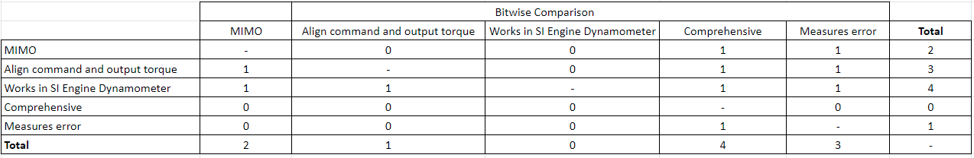
Concept Selection: Piecewise Bitwise Comparison

Slide 37
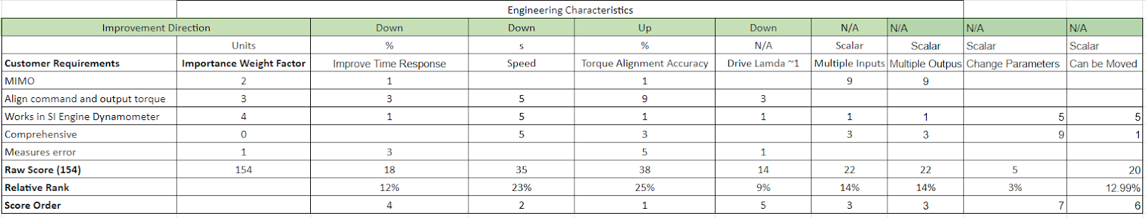
Concept Selection: House of Quality

Slide 38
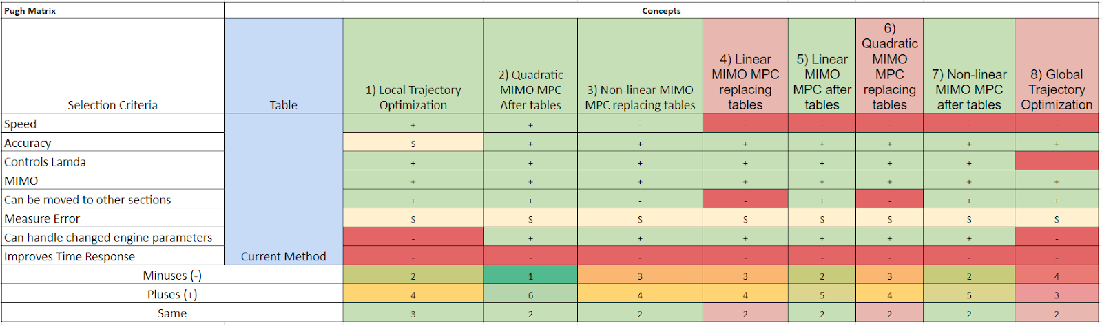
Concept Selection: Pugh Matrix 1

Slide 39
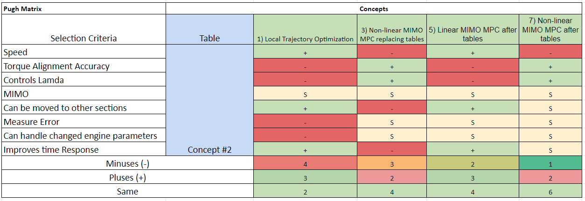
Concept Selection: Pugh Matrix 2

Slide 40
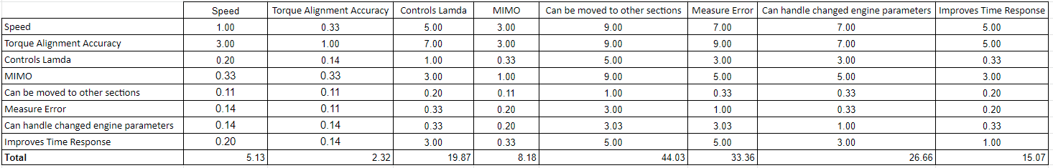
Concept Selection: AHP Criteria Comparison

Slide 41
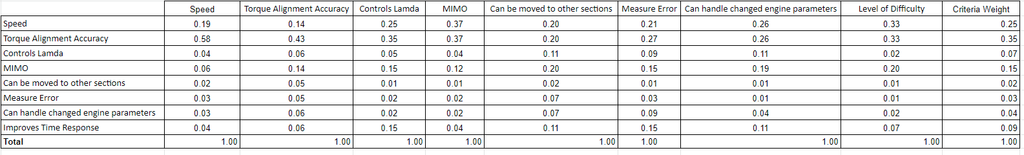
Concept Selection: AHP Normalized Criteria Comparison

Slide 42
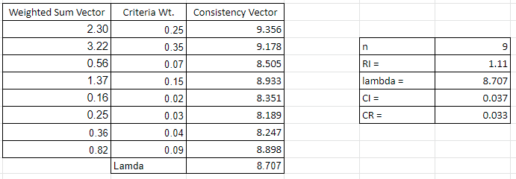
Concept Selection: AHP Final Validation

Slide 43
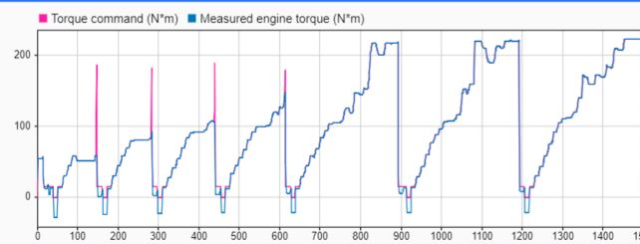

Dynamometer Torque Response

Slide 44
Motivation
Jonathan Wozny
Notes:
We are starting the process of modernizing their engine control unit with multi-input multi-output → their control setup is pretty outdated and used only single input single output

